Slide 1

Start-up Success Prediction
Project by Shrita Gaonkar
Facilitator: Marcos BittenCourt

Slide 2
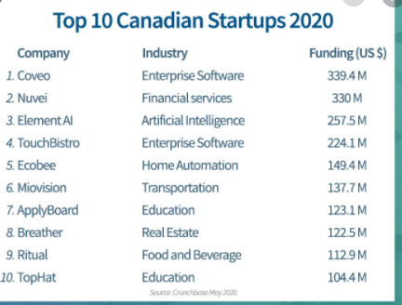
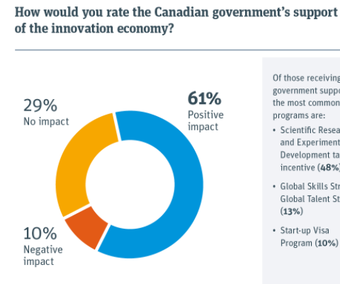
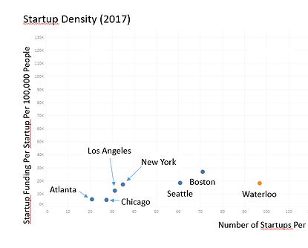
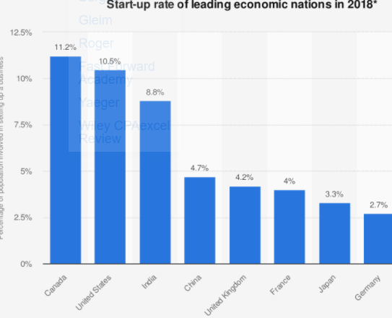
What are start-up companies?

Slide 3
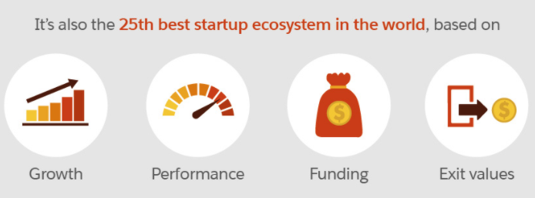
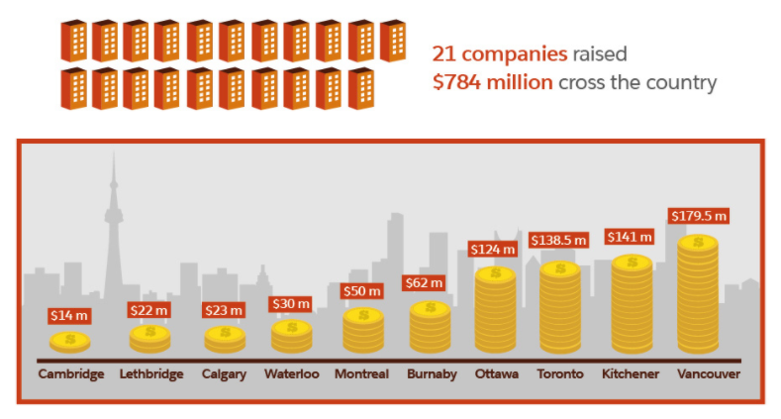


Why Canada is the latest hotspot for start-ups

Slide 4







Types of startups
Scalable startups
Buyable start-ups
Small scale start-ups

Slide 5

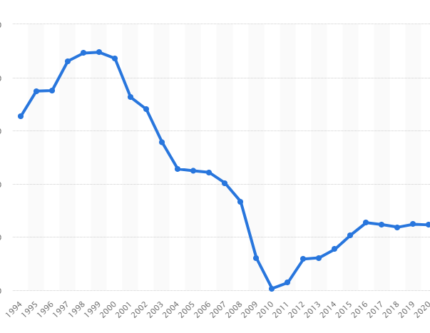
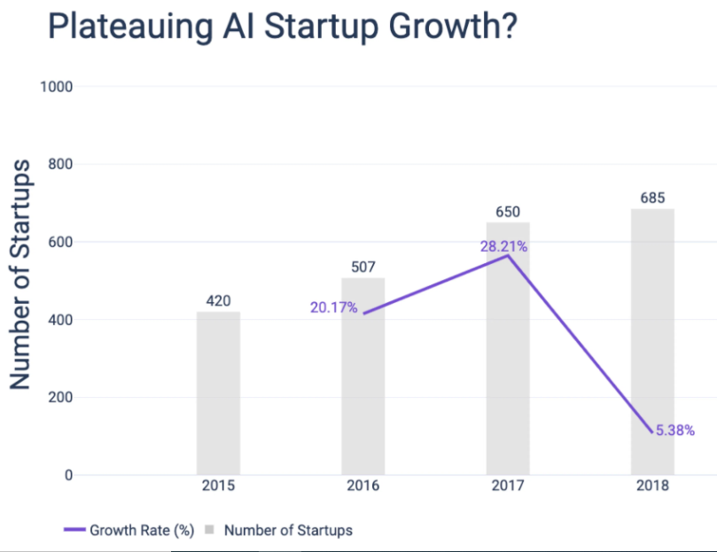
Why Start-ups?

Slide 6
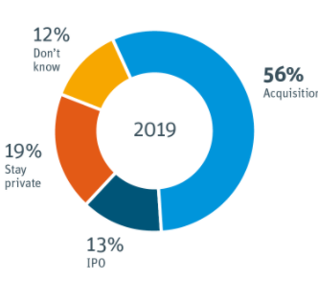

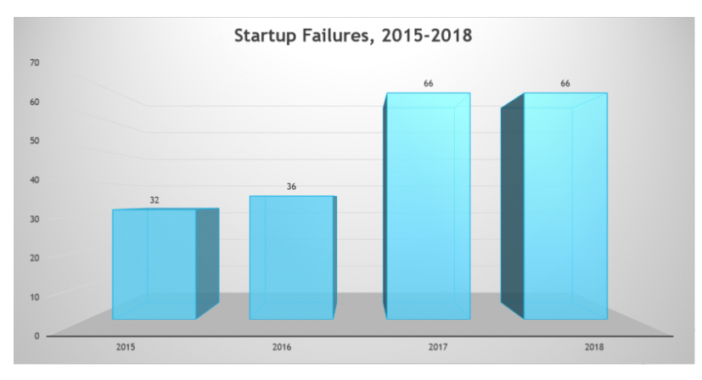
Why prediction of start-up success is needed?

Slide 7
Model Deployment Steps
Train and Test machine learning model
Create Webapp using Flask and HTML
Commit model and webapp to GitHub
Link GitHub to Heroku(PaaS)
Deploy the model
Webapp ready

